Slide 1
Portfolio designs – user interface and content

Slide 2
Aims

Slide 3
What should go into your designs
Audience and purpose of your website
Timeline – key stages of the project life cycle (Gantt chart)
Content – files and assets required, formats and folder structure
Structure chart – to show how all pages are link (site map)
Storyboards – a panel for each webpage (wire frames)
User interface – formatting, assets and navigation
Alternative design ideas
Presentation of content – file folders, compression, accessibility

Slide 4
User interface
Page formatting includes the colour scheme you choose for your website and the fonts used
It is advised that you stick to a similar and appropriate colour scheme throughout your website
It is also advised to keep similar font styles and colours, also make sure to choose an easy-to-read font
Navigation between your webpages are important, how will users move through your website?
You should keep an easy-to-use and consistent navigation throughout
The last point of the interface is the assets required – images/sounds/videos

Slide 5
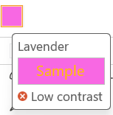
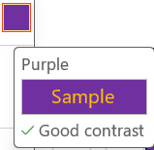
Use of colour – good/bad contrast
Hello
Hello

Slide 6
Different fonts – good and bad
Testing Fonts (Aptos)
Testing Fonts (Blackadder ITC)
Testing Fonts (Bush Script MT)
Testing Fonts (Lucida Sans)
Testing Fonts (Georgia)

Slide 7
Digital portfolio content
For your digital portfolio you must consider the content to put in and how you will arrange that content
You must add a snapshot of your experience and any projects you have undertaken
Consider the file formats you will use for your assets – some file formats are more suitable for the web.
This is where compression comes in. You want good quality pictures but you want them to have as small file size as possible. There is always a trade off here
The accessibility of the content on your website. If the target audience cannot see, read or understand parts of your portfolio it won’t be as effective as it could be

Slide 8

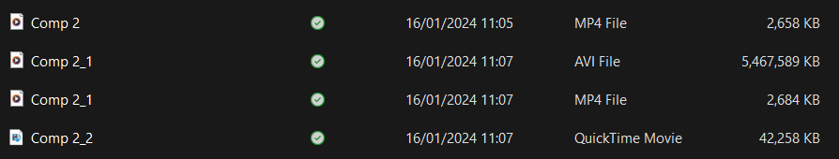
File types and compression
Here are 4 files of the same animation rendered out using Adobe Premier Pro
The animation is short and just has a PNG of DVD on a white square bouncing around the screen
Notice the AVI file is over 5GB in size! No real change in quality (as it is a simple animation)
Definitely not suitable for the web
Could not get the QuickTime Movie to play

Slide 9
Task
Continuing with your portfolios
Read assignment brief
Ask questions

